Slide 1
MBSA Learning Management System
New Company Setup Guide

Slide 2
Getting Started
On the home page, click on the Register New Company button.

Slide 3
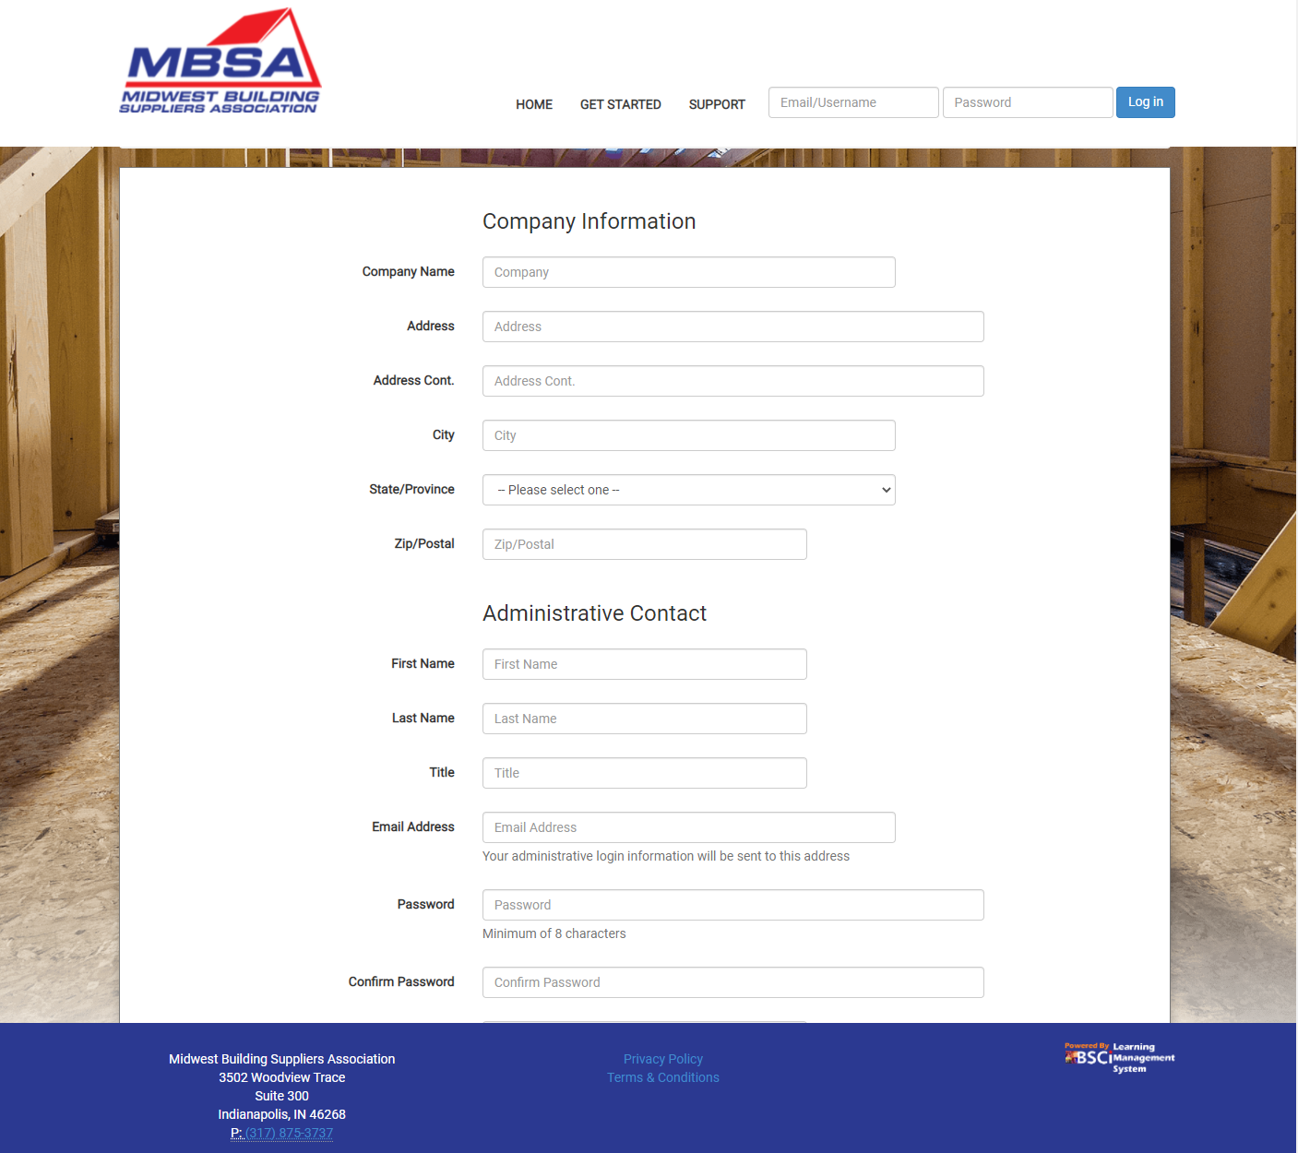
Creating a New Company Account
Fill out your company information.
As the company administrator, you will next fill out your information.
Then, click the Create Company Account button at the bottom of the form.

Slide 4
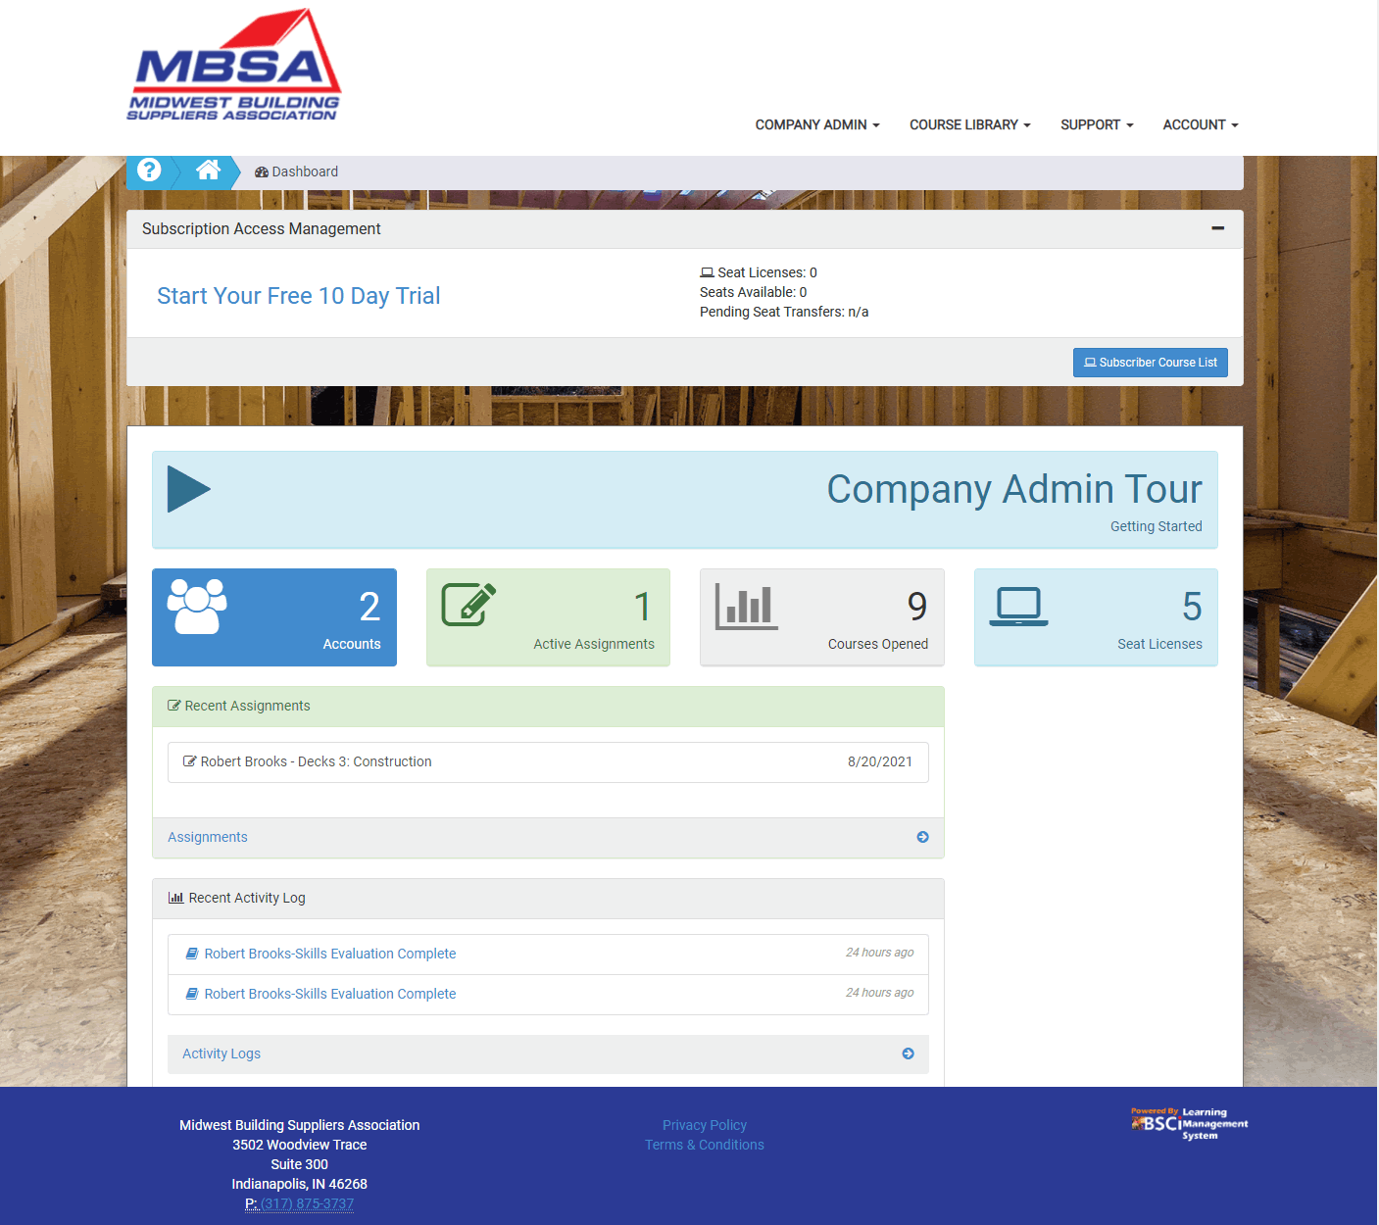
Company Admin Dashboard
Now that you have created your new company account, let’s add employee accounts by clicking on Accounts.

Slide 5
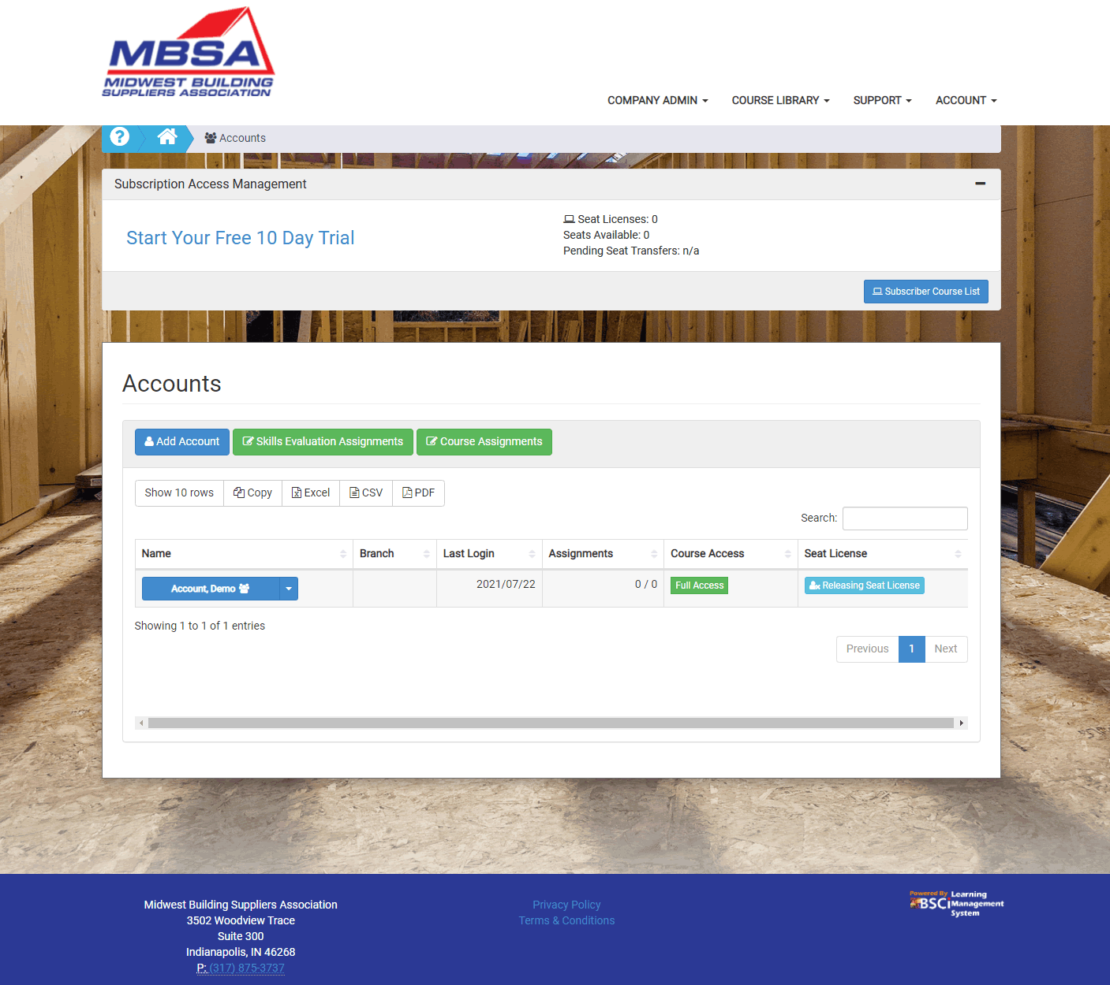
Accounts
Click on the Add Account button to create an trainee account.

Slide 6
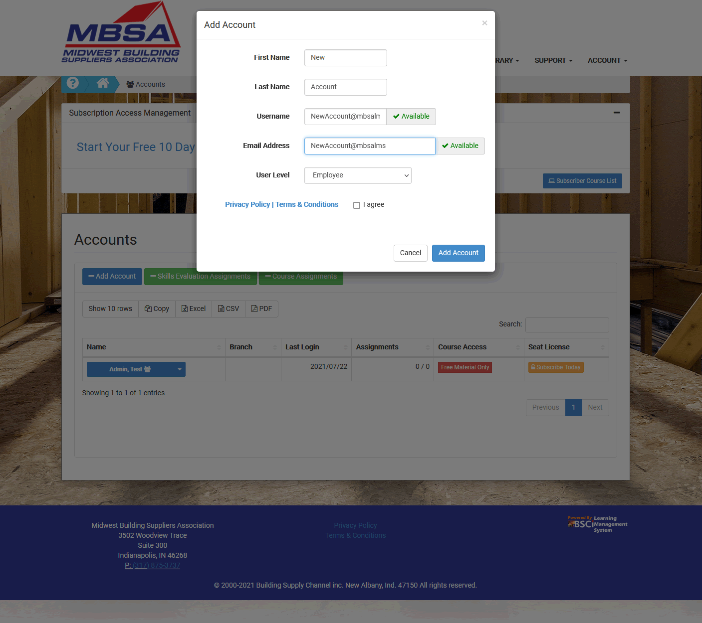
New Accounts
Fill out the trainee information form and click Add Account.
The trainee will receive an email notification that will include website link, username and a temporary password. You may create as many accounts as you need.

Slide 7
Free Trial
To access the training material, each trainee account will need a seat license. Click on Start Your Free 10 Day Trial to view the seat license plans.

Slide 8
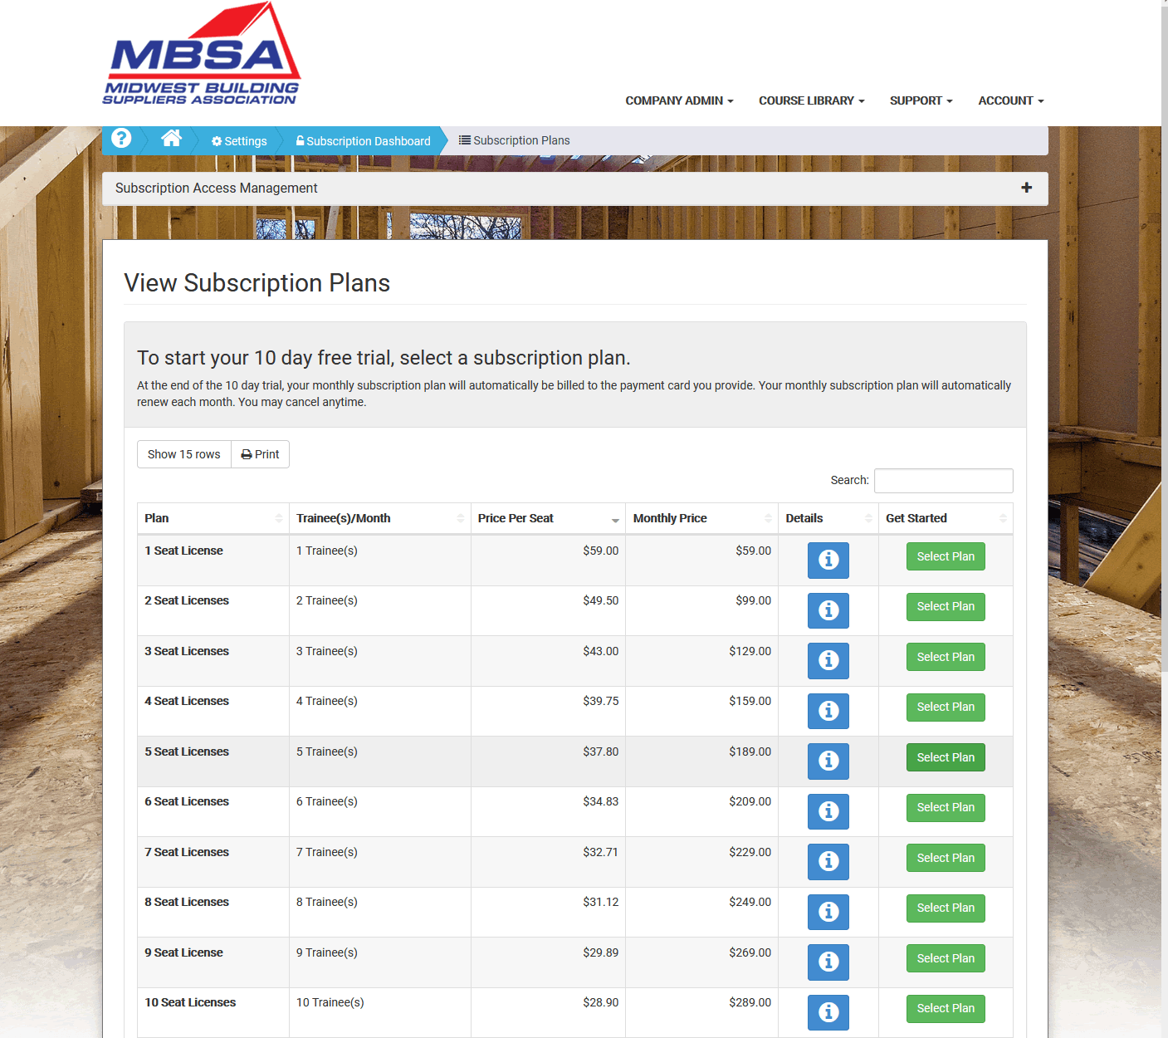
Subscription Plans
Select the plan that best fits your training goals. Seat licenses may be queued up to transfer between trainee accounts.
For example, if you have 10 employees that need training, you can select the 10-seat license plan. This will allow all the trainees to access the training materials at the same time. Alternatively, if you select the 5-seat license plan, you can assign the 5 licenses to the first group. Then once a trainee from the first group has finished their training, simply queue that license to transfer to a trainee in the second group. At the beginning of each billing cycle, the system will automatically process the transfer queue.

Slide 9
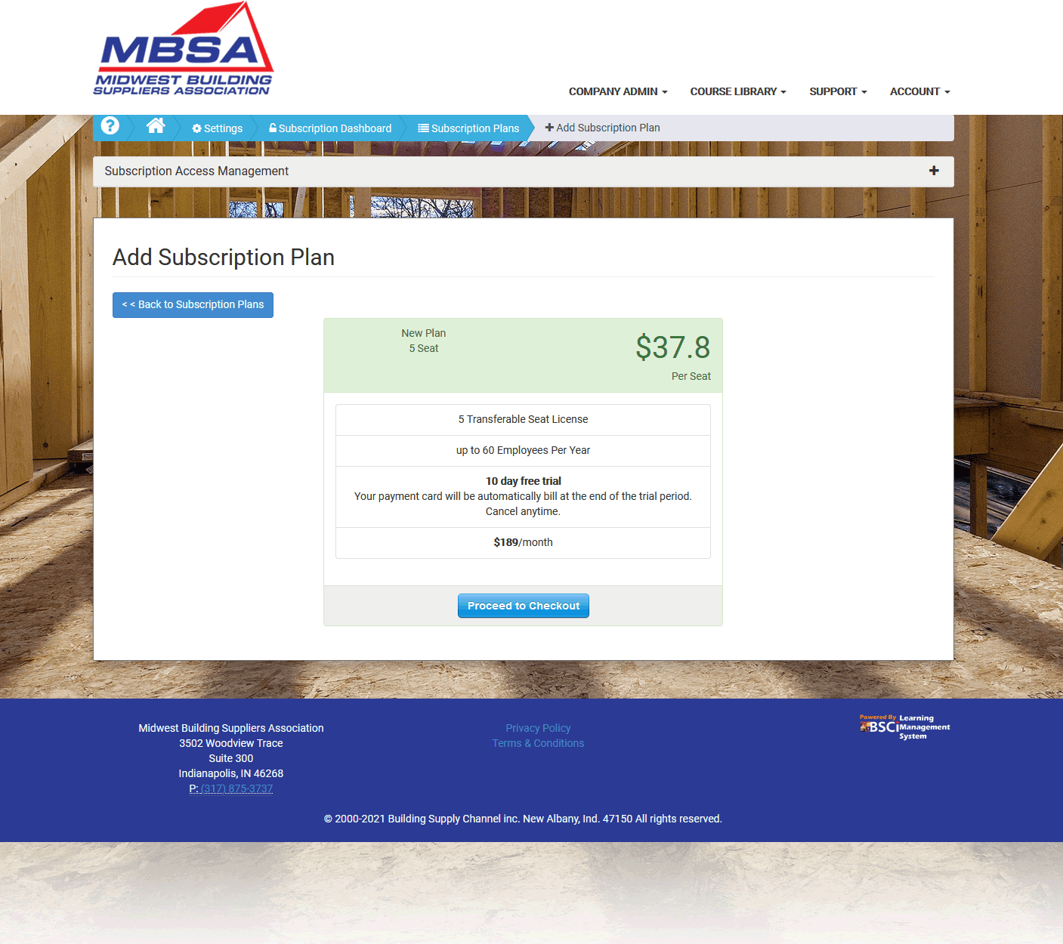
Checkout
Once you have selected a subscription plan, follow the checkout procedure.

Slide 10
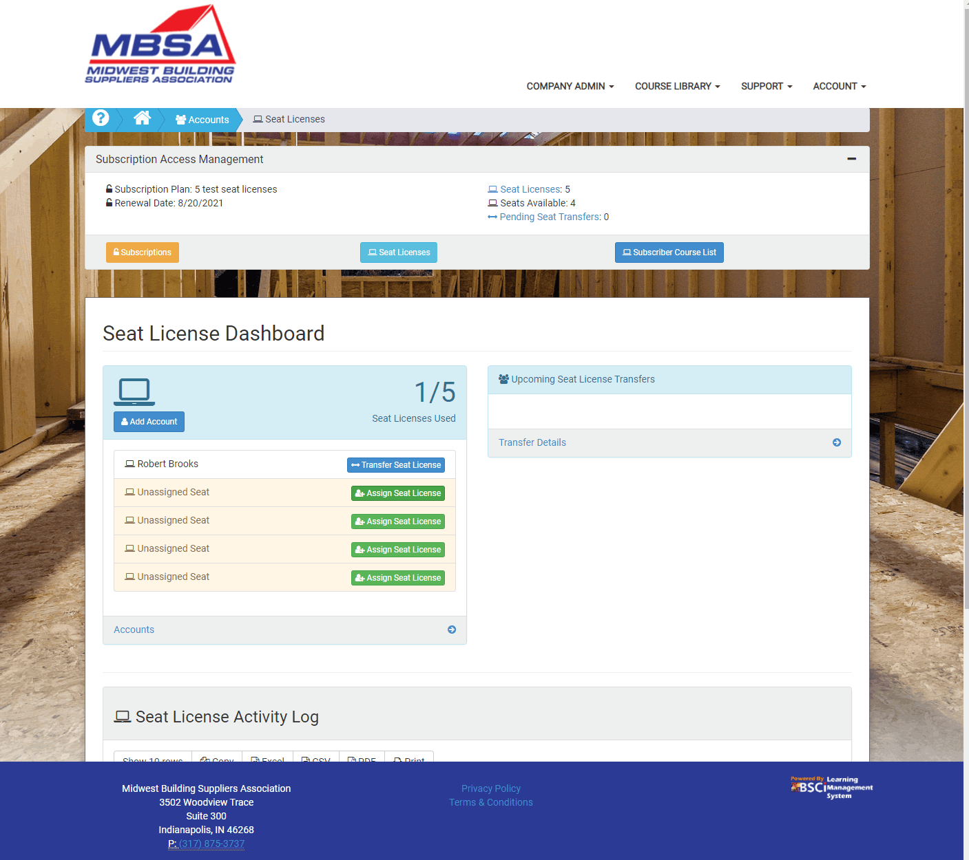
Seat License Dashboard
With checkout complete, you can now start assigning seat licenses from the Seat License Dashboard.
Click the Assign Seat License button.

Slide 11
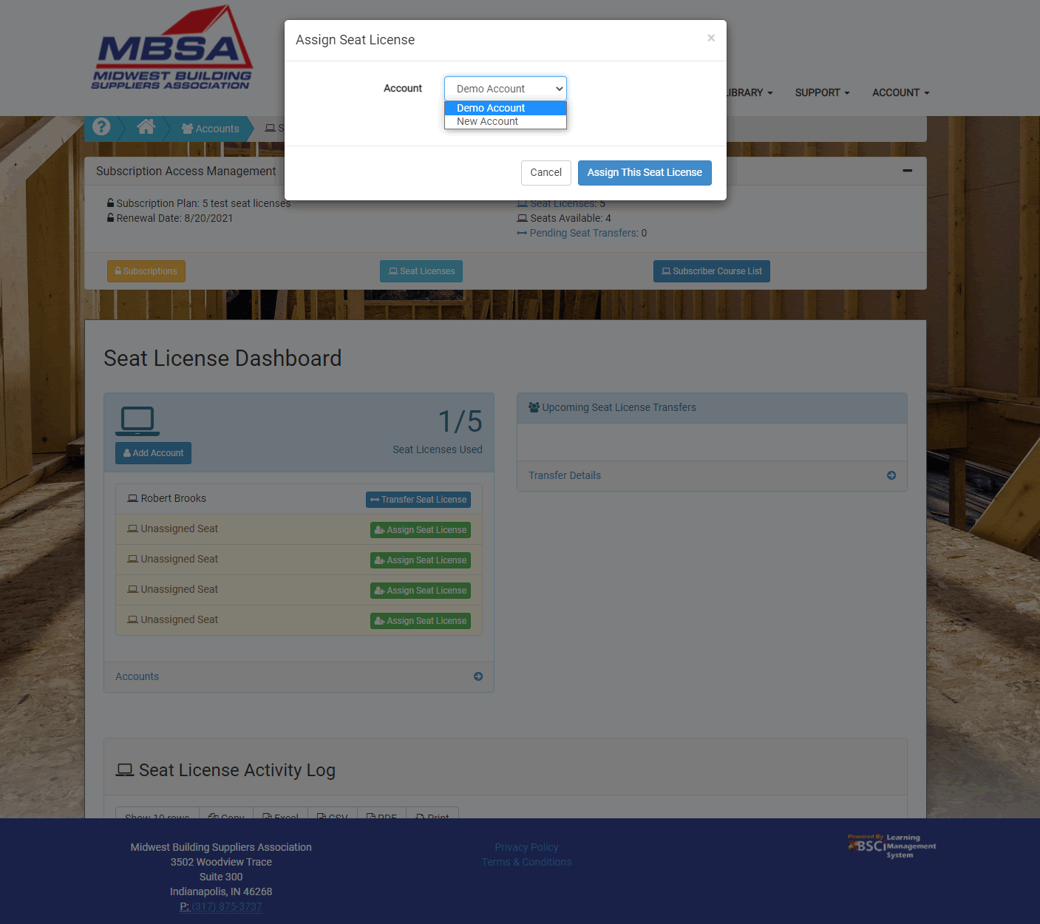
Seat License Dashboard – Assign Seat
Select the trainee account and click the Assign This Seat License button.
Once a license has been assigned, your trainee will have full access to the course library, and you can start creating course assignments.

Slide 12
Assignments
To start creating assignments, click on Active Assignments.

Slide 13
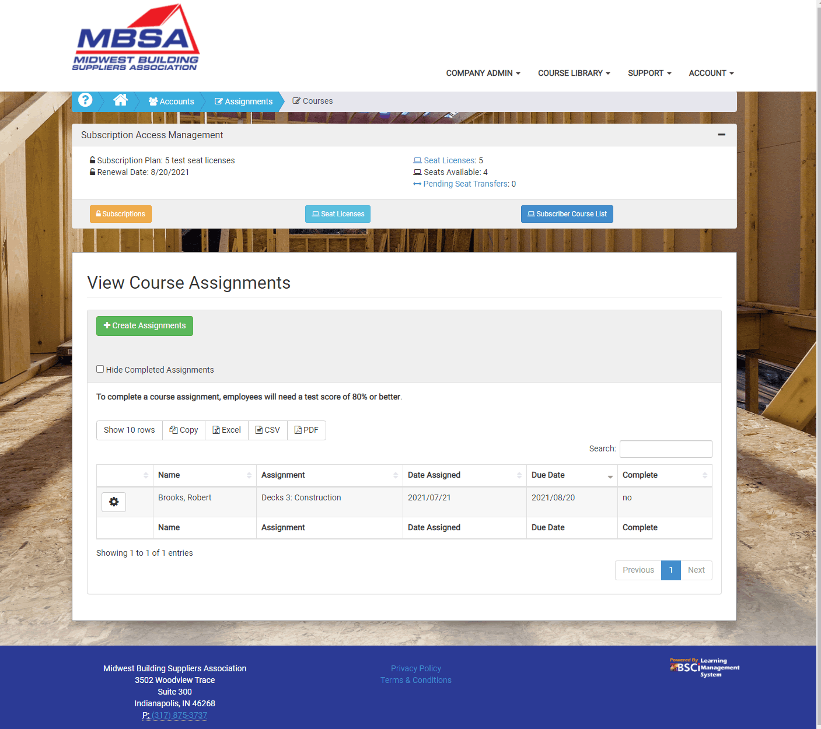
Creating Course Assignments
To create a new course assignment, click the Create Assignments button.

Slide 14
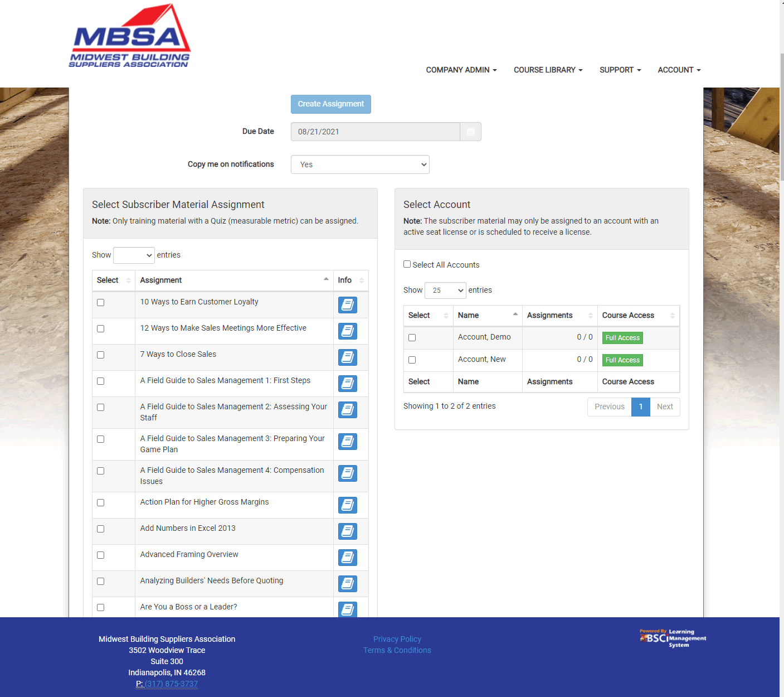
Creating Assignments
When creating a course assignment, first choose the due date.
Next, select the course(s) that will be assigned.
Then, select the account(s) that will be assigned those courses.
*please note, only accounts with a seat license may be assigned courses.
Last, click the Create Assignment button at the top.

Slide 15
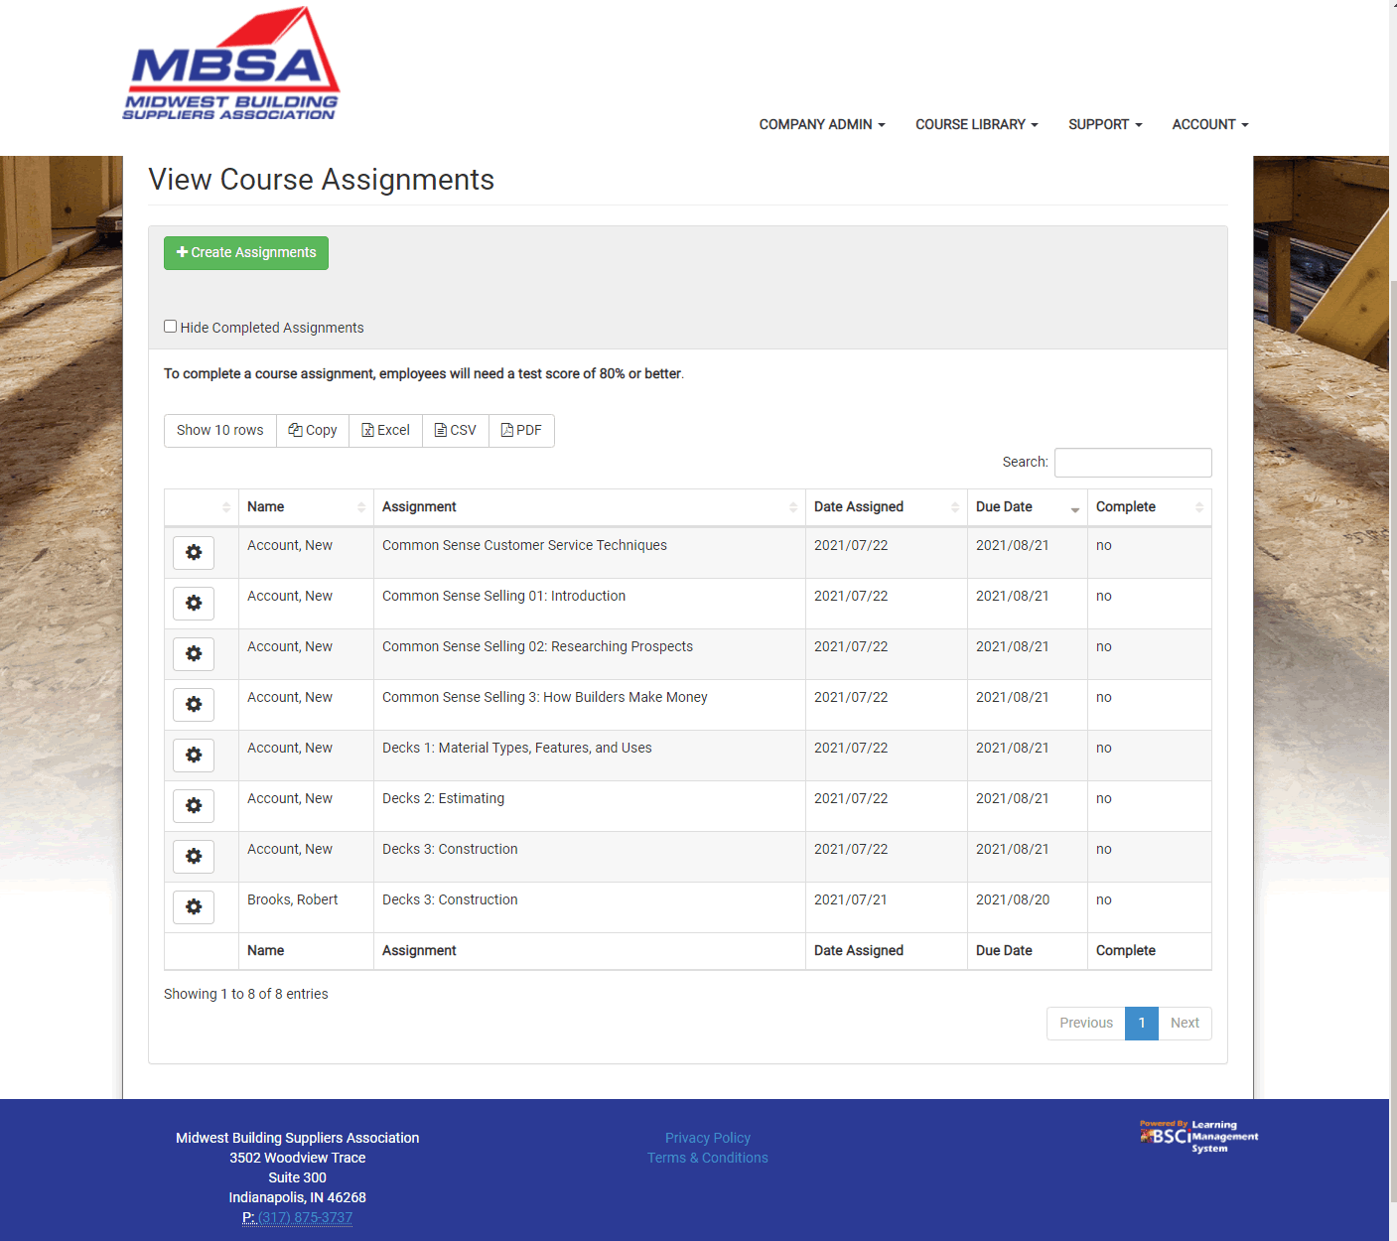
Viewing Course Assignments
The new assignments and their status will be listed in the table below.

Slide 16
LMS Support
If you have any questions or run into any trouble, please drop me a line.
Thanks – Robert
Robert Brooks
LMS Director, The Building Supply Channel, inc.
502.376.0405
Robert@BSCiLMS.com

